Slide 1
Breaking the Mold: Exploring Gender Stereotypes in Popular Media

Slide 2

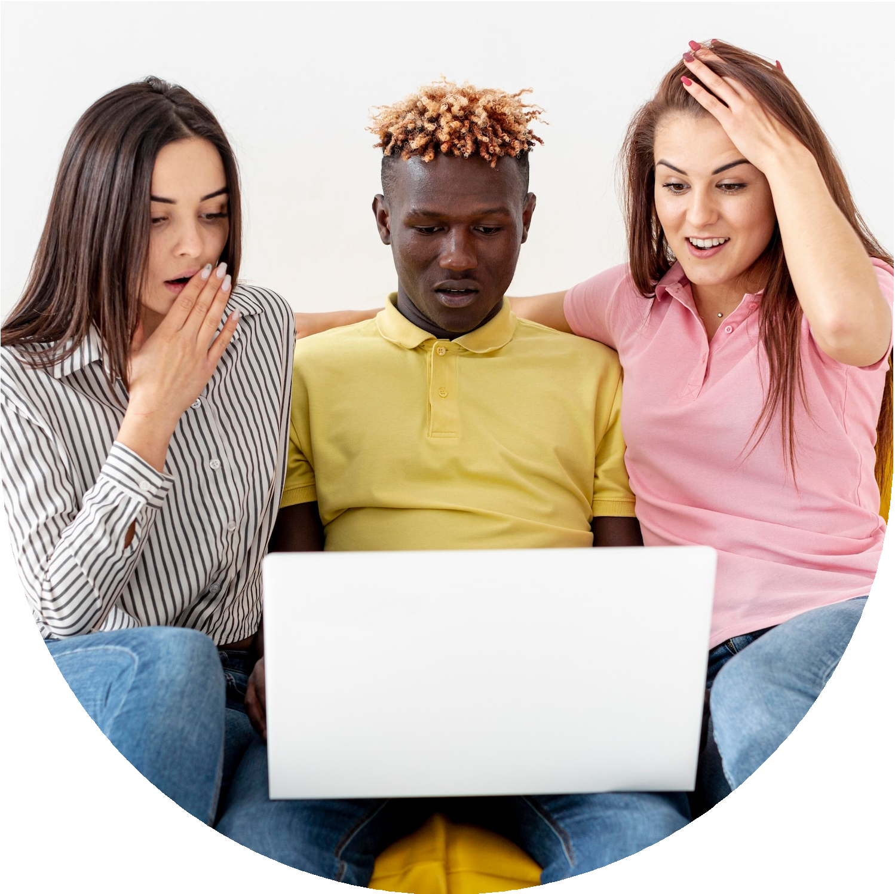

Introduction
In today's world, the media we consume, like TV shows, movies, ads, and social media, can shape how we see things. Sometimes, they show outdated ideas about what boys and girls should be like. These ideas are called gender stereotypes. They say certain traits or roles are just for boys or just for girls. But these stereotypes can limit people and keep unfair ideas alive. They stop us from being ourselves and treat people unfairly.

Slide 3

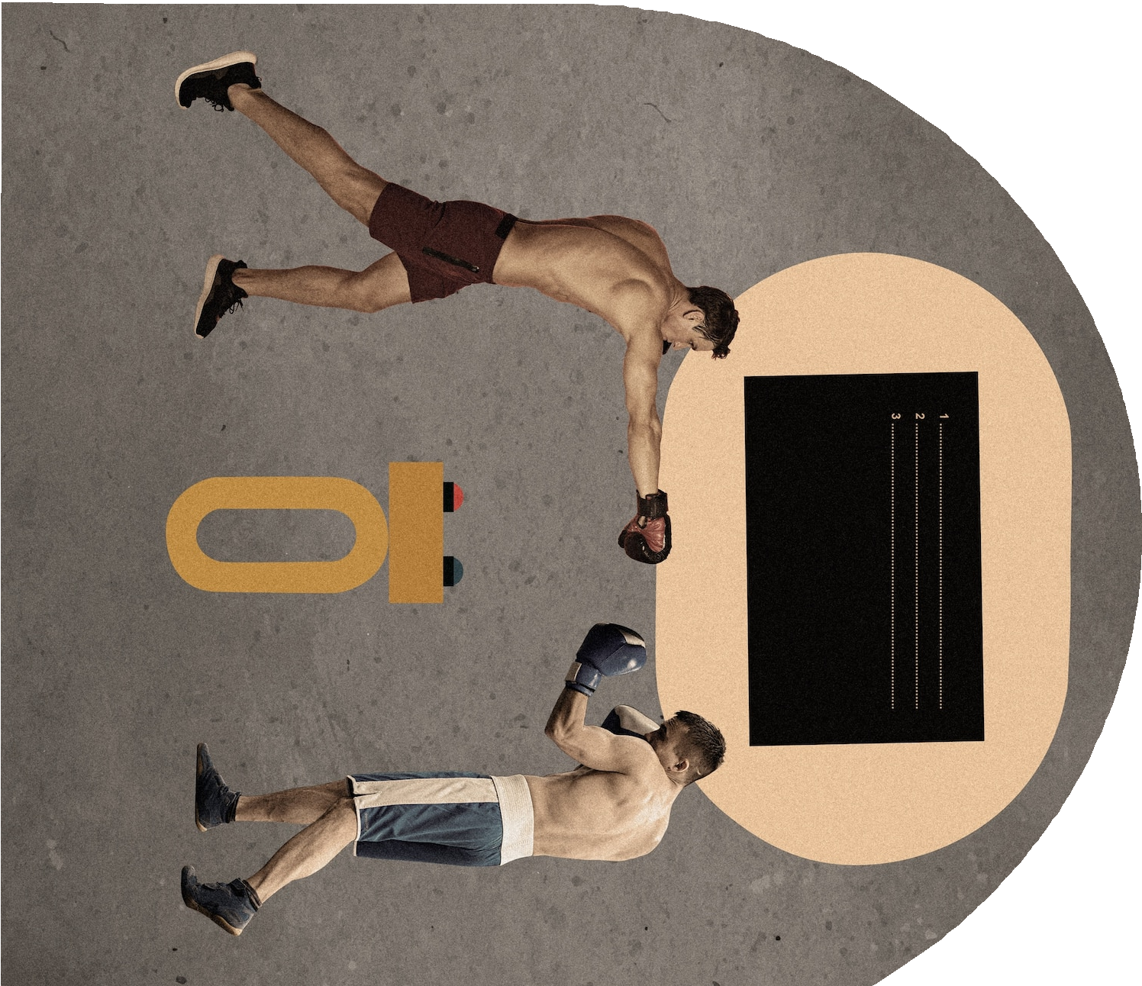

Historical Context
From rigid roles in early 20th-century newspapers and radio to idealised family interactions in 1950s TV, the media's portrayal of gender stereotypes changed with time. Stereotypes remained even after Second Wave Feminism in the 1960s and 1970s brought about reforms. Both progressive and regressive depictions were brought forth by globalisation and the digital era, reflecting changes in society and business objectives. Persistent gender stereotypes highlight the necessity of media literacy and critical analysis even in the face of change. Gaining an understanding of this historical context is essential to placing current media depictions in context and moving towards more inclusive and equitable representations.

Slide 4
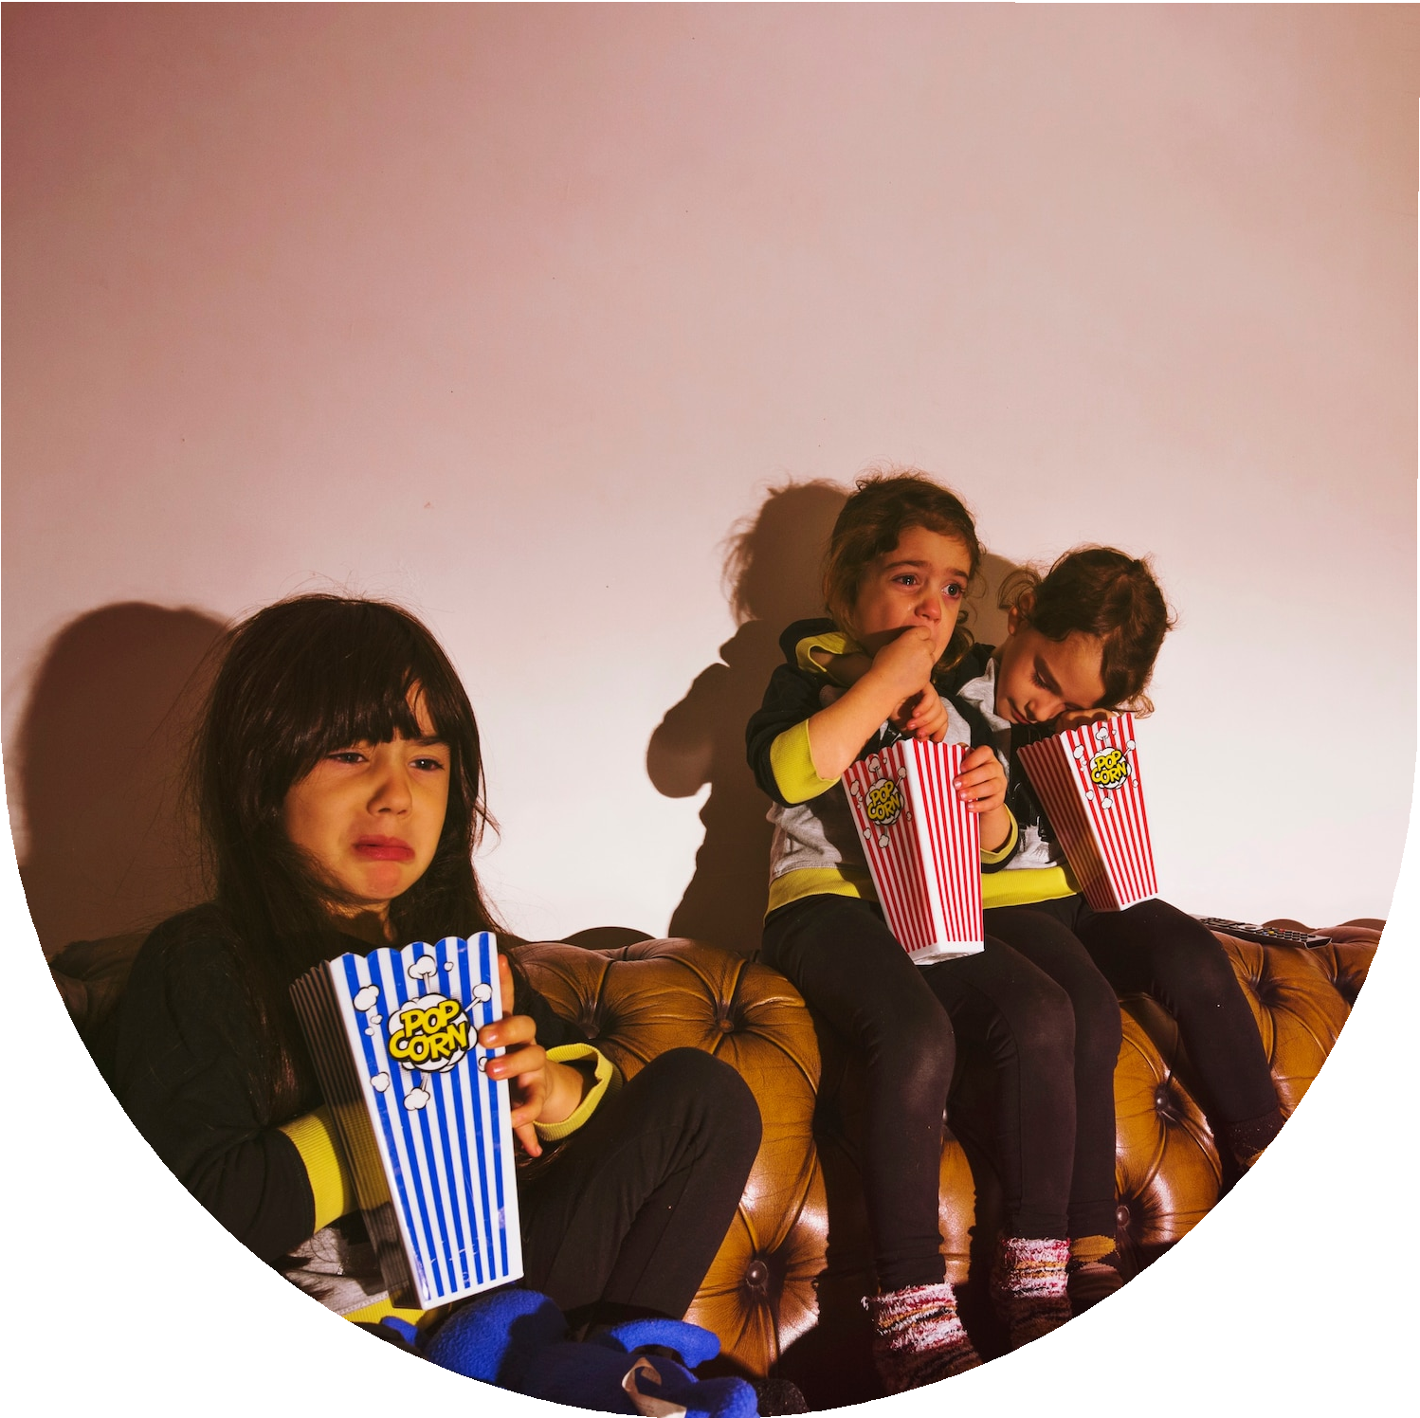
Impact on Youth
The way gender norms are portrayed in popular media has a big impact on young people. Their views of gender roles are shaped, which affects how they create their identities and how they accept social standards. Limited role models and unrealistic beauty standards can have a negative impact on one's ambitions for a job and self-worth. Stereotypical media exposure increases gender inequity and supports traditional behaviours. Understanding these effects is essential for encouraging gender equality, healthy self-concepts, and youth empowerment to question social norms.

Slide 5
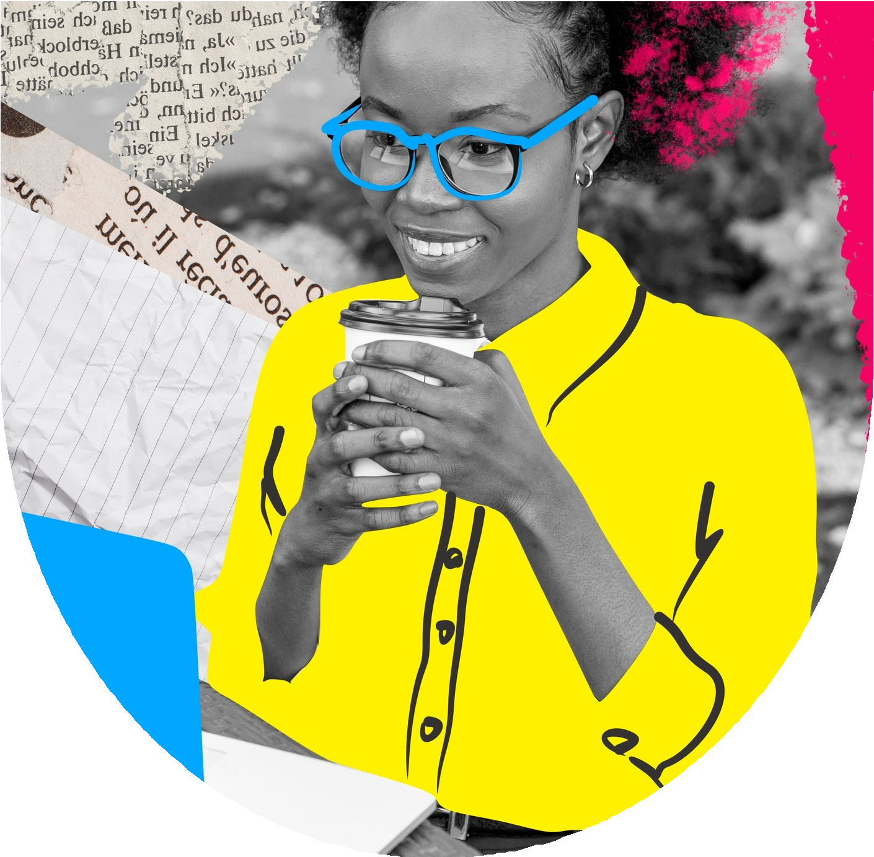


Reinforcing Stereotypes
Through characterizations, appearances, jobs, stories, and social interactions, popular media perpetuates gender stereotypes. Female characters are portrayed as reliant and nurturing, whereas male characters display stoicism and dominance. Body image problems are perpetuated by unrealistic beauty standards. The persistence of traditional gender norms restricts employment opportunities. Storytelling devices such as the damsel in distress serve to normalise imbalances in power. By perpetuating negative gender stereotypes, these representations limit the range of identities and experiences that can be shown. Promoting gender equality and creating a more inclusive society require acknowledging and combating these media prejudices.

Slide 6
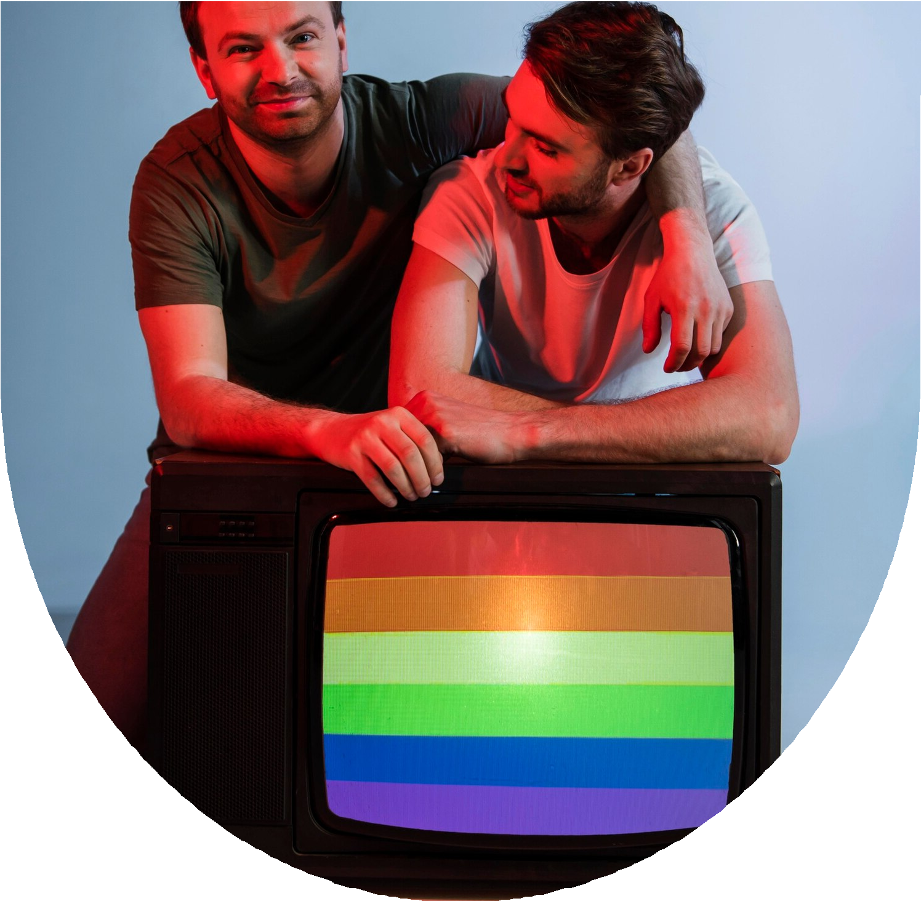

Breaking Barriers
Diverse Representation: The media challenges binary thinking by showcasing a variety of gender identities.
Complex Characters: Individuals transcend stereotypes by exhibiting a variety of facets.
Intersectionality: Images take into account how gender intersects with other identities, such as race, ethnicity, and sexual orientation.
Empowerment Narratives: These are tales of people overcoming barriers based on their gender, motivating change.

Slide 7
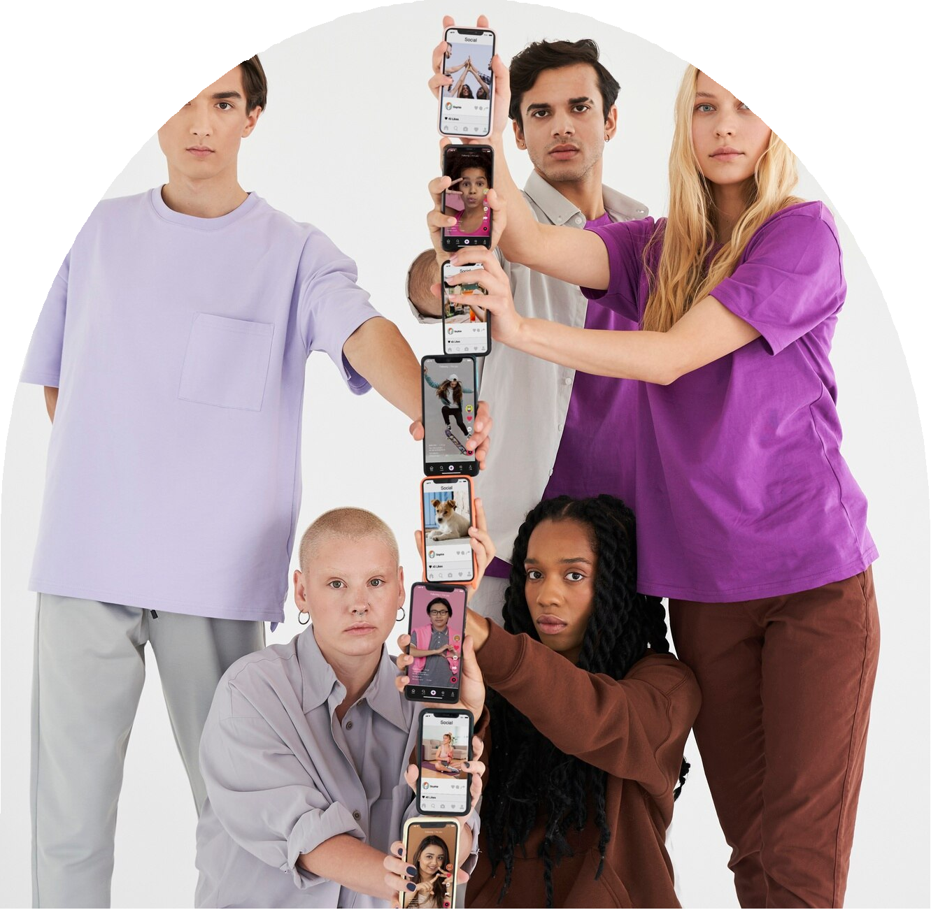
Positive Representation
By celebrating diversity and dispelling preconceptions, positive media portrayal strengthens marginalised groups. By presenting genuine and complex portraits of people from different origins, it promotes empathy and understanding. Positive representation in the media fosters inclusivity and gives marginalised voices a platform to be acknowledged and heard.

Slide 8


Challenging the Status Norms
By presenting a varied cast of characters and stories that subvert prejudices, media undermines established norms. It affects society ideas and promotes conversations on gender equality by defying expectations and presenting non-traditional gender roles. Through motivating action and advocating for inclusive depictions, the media is essential in fostering social change and advancing social justice.

Slide 9



Media Responsibility
It is the duty of the media to advance truthful and varied depictions of gender. Positive societal attitudes can be shaped and inclusivity can be fostered by resisting harmful clichés and confronting preconceptions. To promote a more just and compassionate society, responsible media practices include presenting gender identities in nuanced and genuine ways.

Slide 10
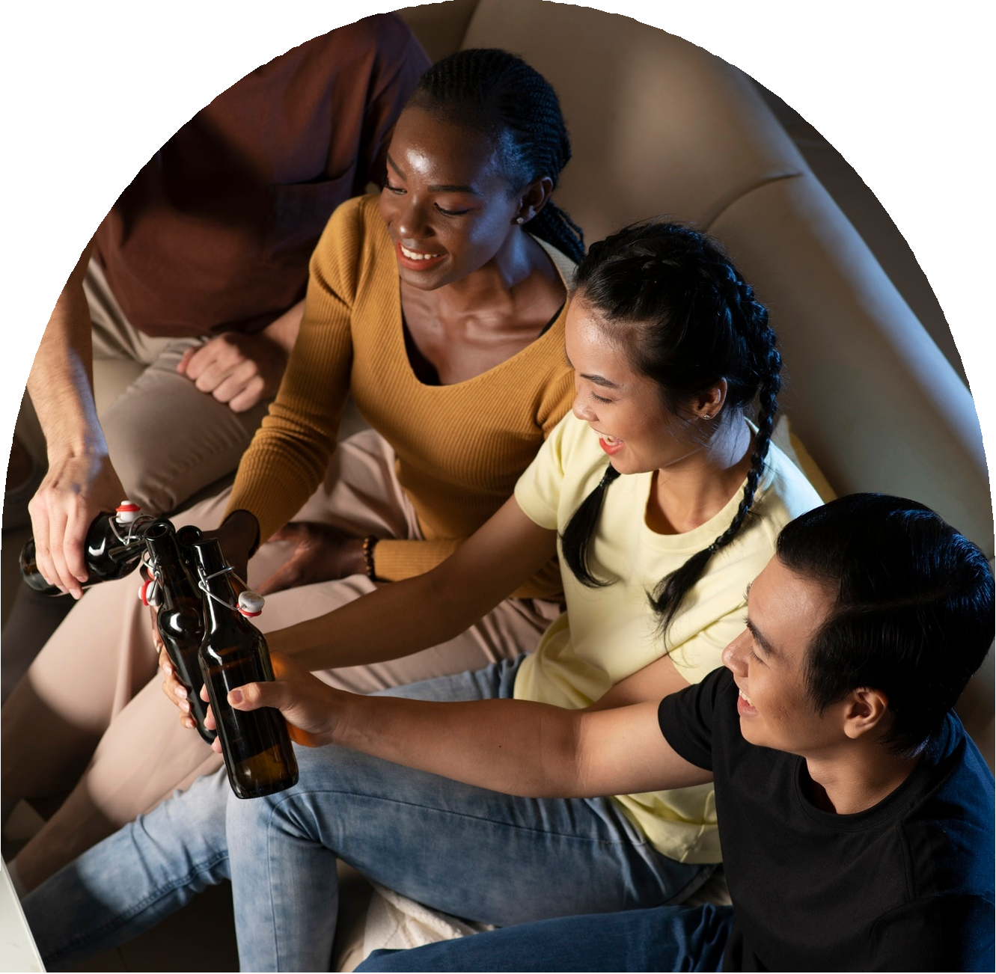
Empowering Future Generations
The media must present a variety of positive role models and narratives that inspire and elevate if it is to empower the next generation. The media should shape a generation that is ready to embrace diversity, fight for equality, and create a more inclusive and equitable future by featuring inclusive representation and positive messaging.

Slide 11


Conclusion
In conclusion, gender stereotypes in popular media remain a pervasive and concerning issue
with significant implications for society. Efforts to challenge and deconstruct these
stereotypes are crucial for promoting gender equality, diversity, and inclusivity in media
representation. By fostering more accurate and nuanced portrayals of gender, media can play
a transformative role in shaping attitudes and perceptions towards gender roles and identities.

Slide 12


Thanks!

